Slide 1
VRP Project

Slide 2


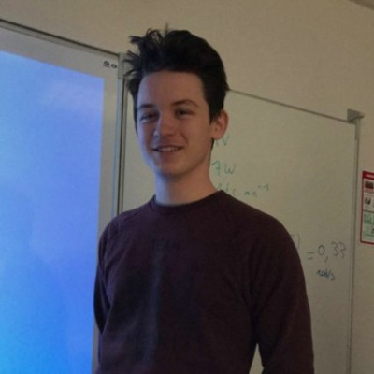
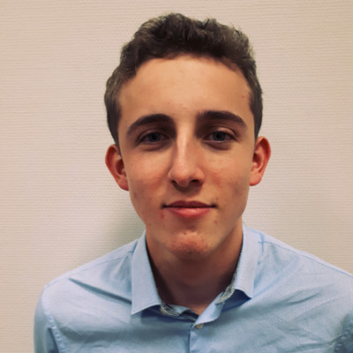
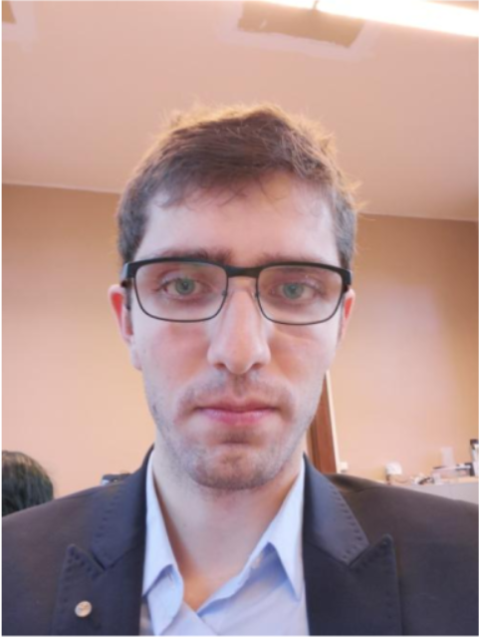
Team presentation
Devrouete
Corentin
Jacob
Antonin
Keurinck
Théo
Larose Hugo
Genty Aurélien

Slide 3
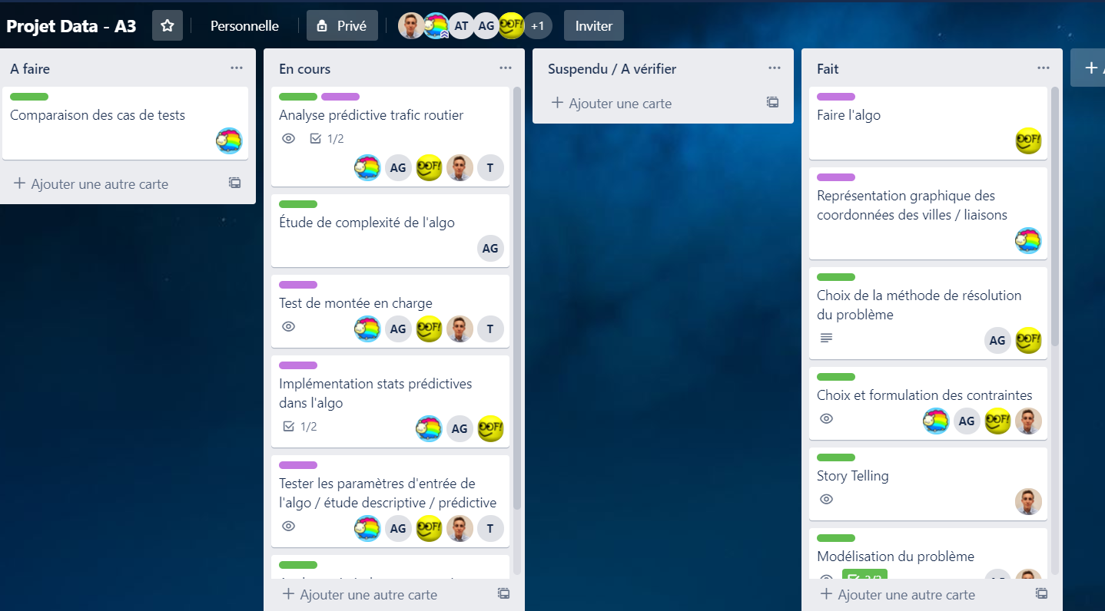
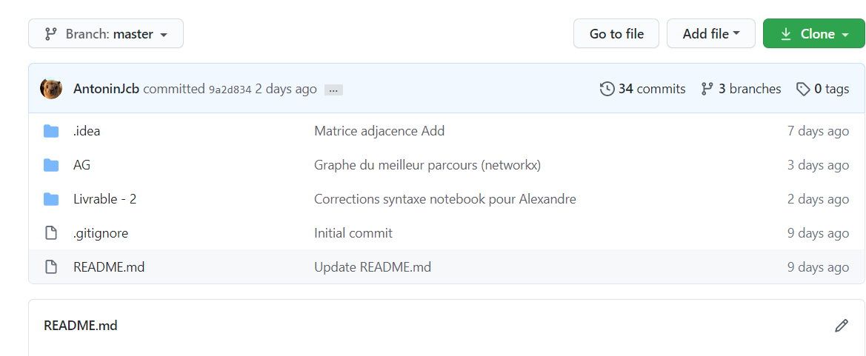
Organisation

Slide 4
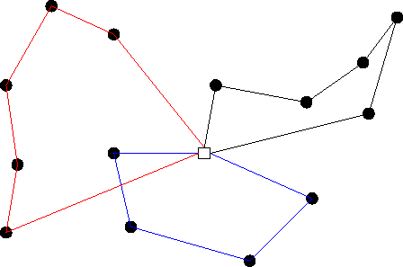
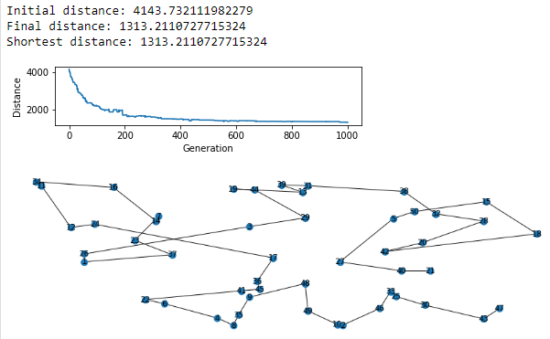
Problem presentation

Slide 5
Modeling
We have the modeling of the problem, presenting the complexity of it
Then algorithmic modeling, presenting the genetic algorithm, its code and the constraints.

Slide 6
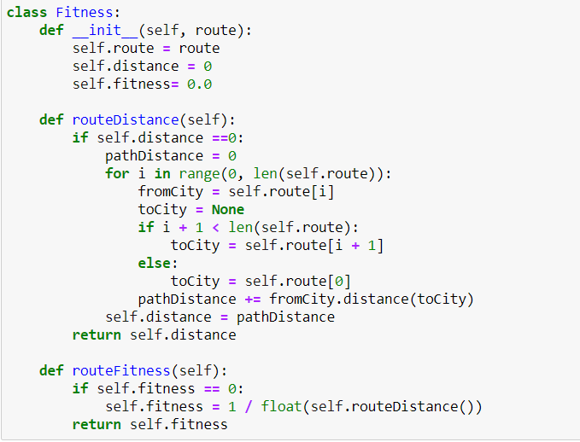
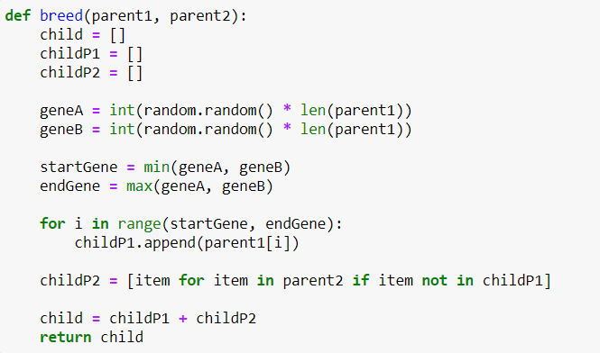
Technical realization
We therefore opted for a genetic algorithm in order to obtain an optimal solution for the VRP.

Slide 7
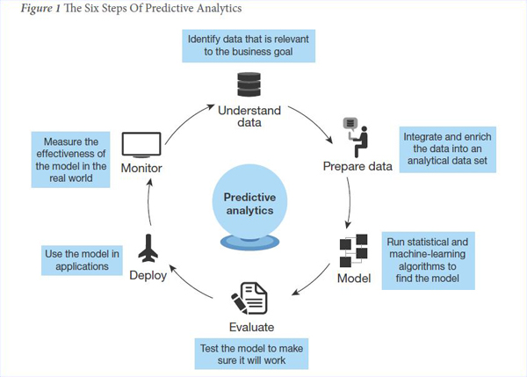
Statistics
Finally, we carried out descriptive and predictive analyzes of the traffic, so as to choose the fastest route.
But we also did multiple tests on the algorithm to have different parameters involved.

Slide 8
Industrial comparison
In an industrial situation, there are several constraints to consider :
Gasoline ;
Employees schedules ;
Real traffic ;
The danger encountered in the road.

Slide 9

Thank you for the listening

